Slide 1

Generative Adversarial Networks (GANs) Clarence Lam

Slide 2
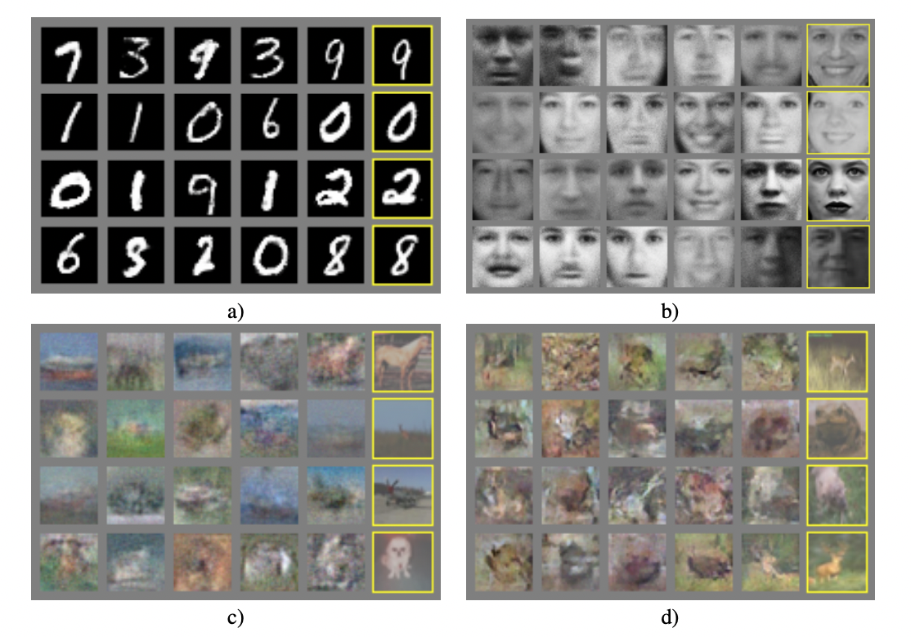
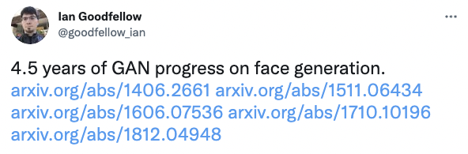
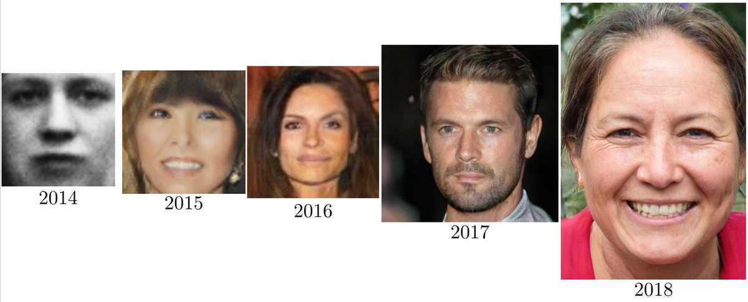
The first GAN (2014)
Goodfellow, I., Pouget-Abadie, J., Mirza, M., Xu, B., Warde-Farley, D., Ozair, S., Courville, A. and Bengio, Y. “Generative Adversarial Networks” Communications of the ACM, 63(11), pp. 139-144 (2014)

Slide 3








Generative Models vs Discriminative Models
→
?
feature
class
error
class
features
X → Y
Ɛ , Y → X
Discriminative Models
Generative Models
P( Y | X )
P( X | Y )

Slide 4
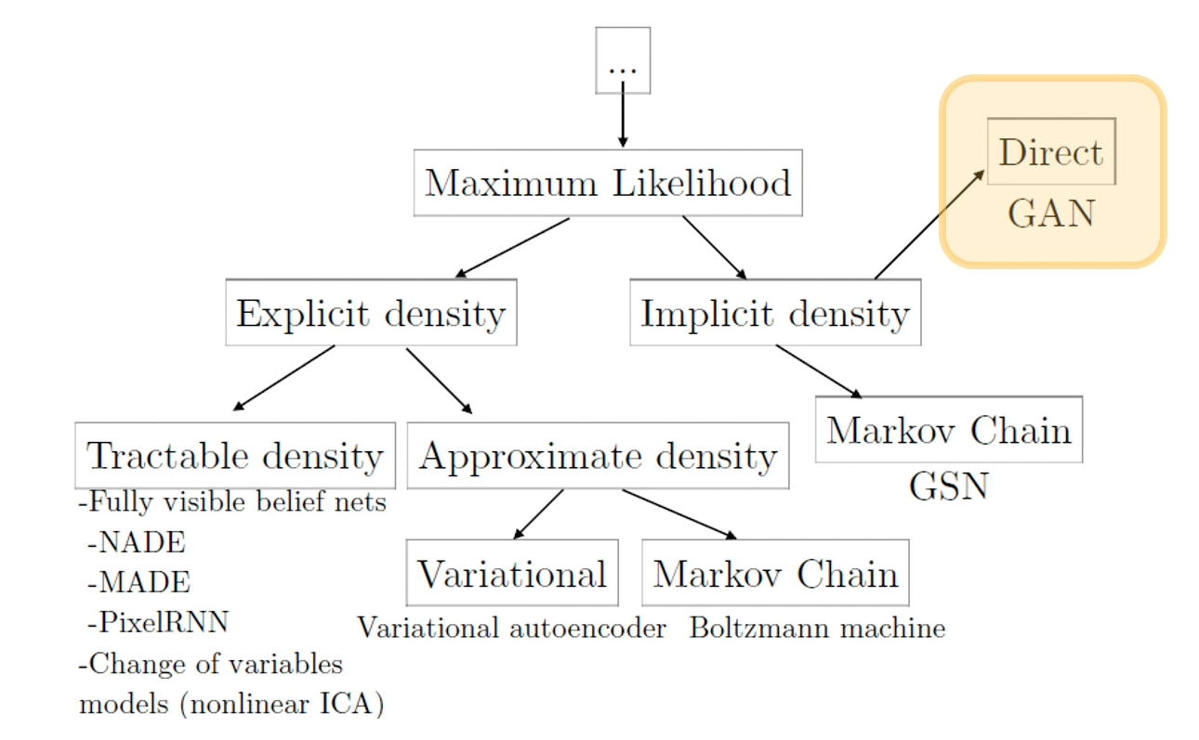
Introduction
A class of generative model that uses of 2 neural networks
Learns a generation process that can give us samples from a joint distribution
Most often associated with generating photorealistic images as a use case but has other uses (i.e. chemical compounds, sketch-to-image translations)
Goodfellow, I. “NeurIPS 2016 Tutorial: Generative Adversarial Networks”
Notes:
GANs do not learn an explicit density function p(x)
Rather, they fit the implicit density category. What that means is that rather than learn a parameterized density function, we will instead learn a parameterized generation process that can give us samples out of a joint distribution.
We won’t have an explicit density to perform things like classification, but we be able to use the unlabeled data to learn how to generate new samples that fits that distribution of that unlabeled data or learn features that might be good for downstream pass.
Implicit generative models do not actually learn an explicit model for p(x)
Instead, we learn to generate or sample from p(x)
It turns out we can learn good feature representations on unlabeled data alone
We can also perform data augmentation and generate new images

Slide 5
Definition
Generative Adversarial Network
Generative Model
With Competing
Neural Networks
Generator
Discriminator

Slide 6
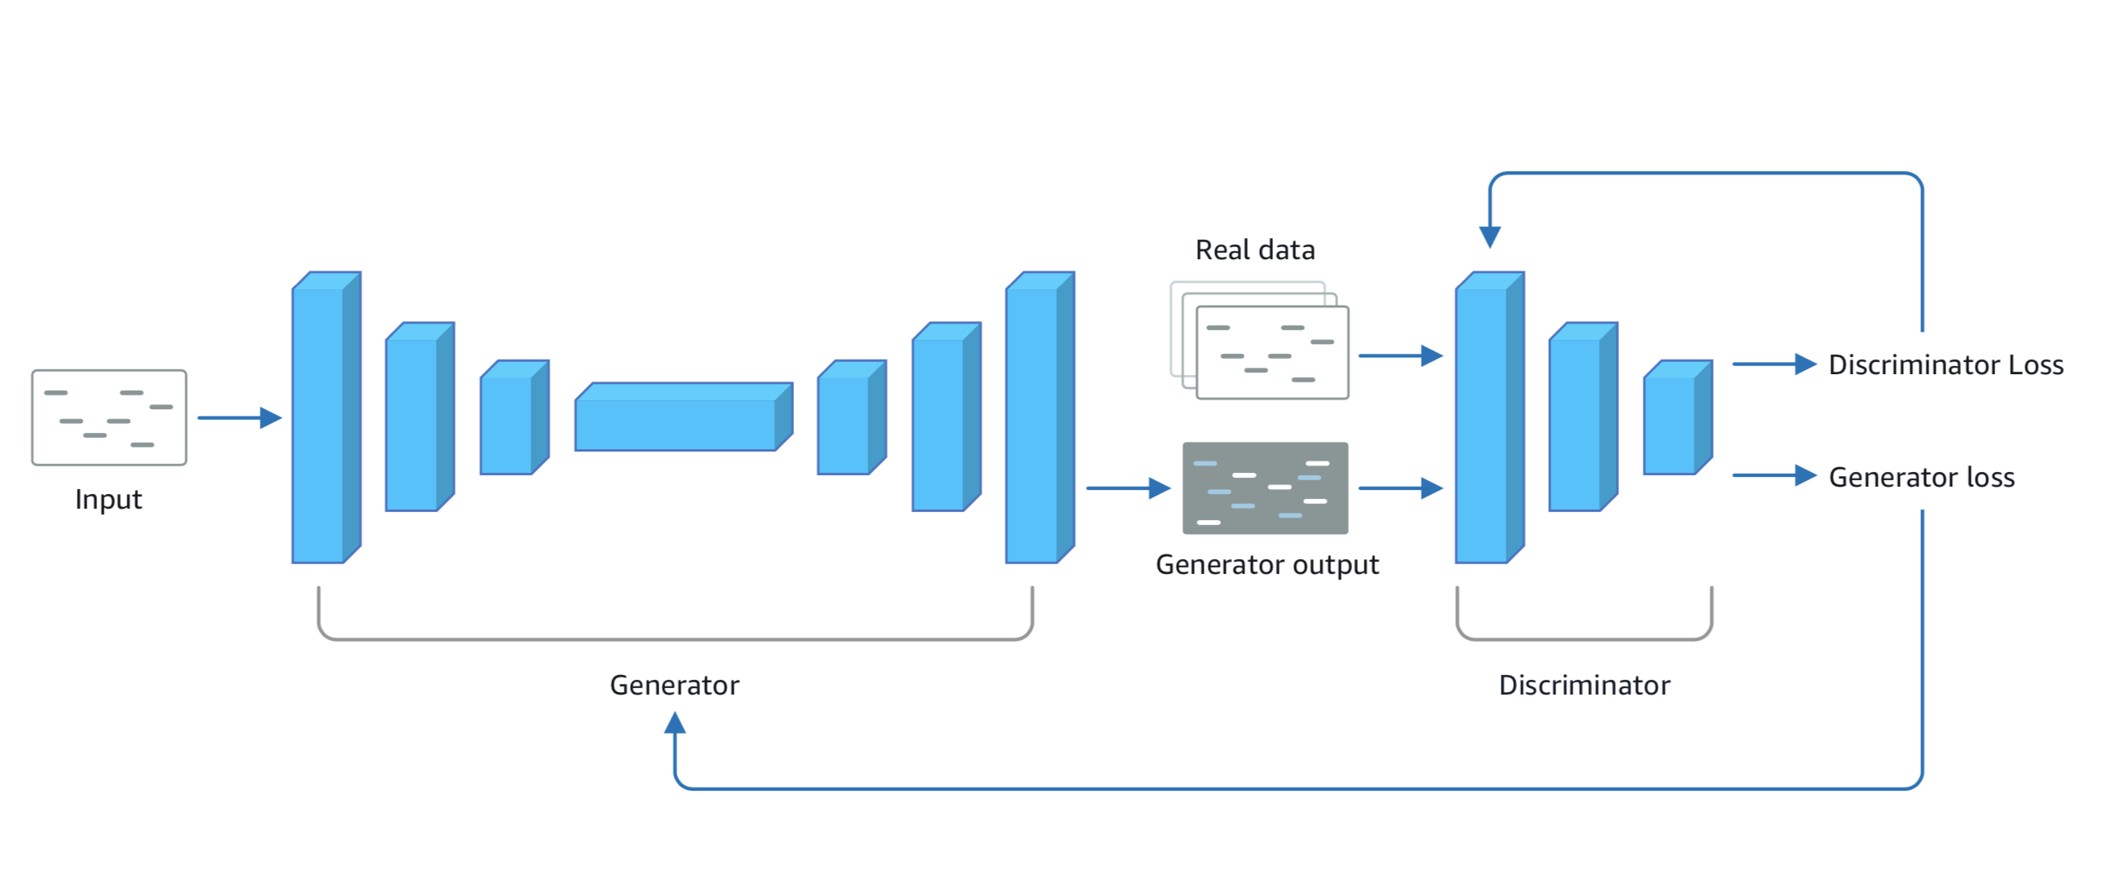
General GAN Architecture

Slide 7
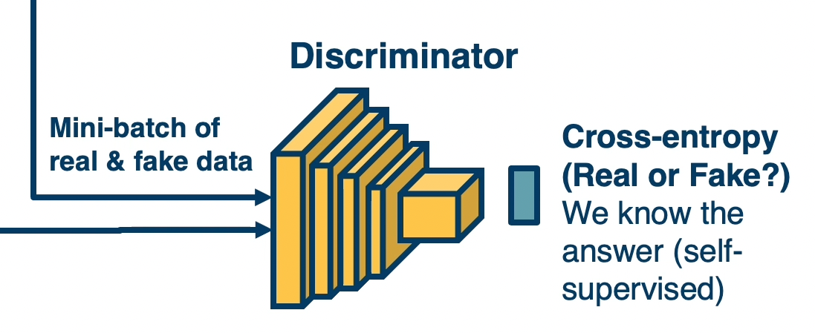
Discriminator
Goal: Update weights to classify real vs generated images
Real Images
Generated
Images
Notes:
In the initial epochs, you will generate random noise. The goal is to generate realistic images.

Slide 8
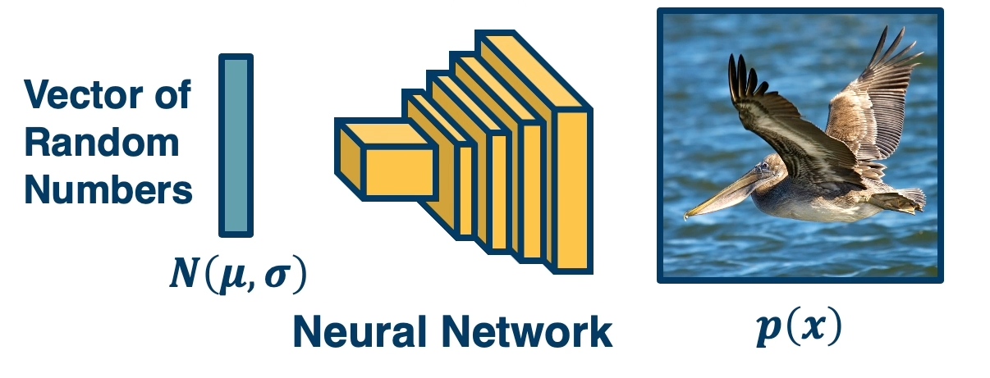
Generator
Goal: Update weights to improve realism of generated images
Notes:
In the initial epochs, you will generate random noise. The goal is to generate realistic images.

Slide 9
Min-max Objective Function
Since we have two networks competing, this is a min-max two player game
Has close ties to game theory
Sampling from fake (0 for fake)
Sampling from real (1 for real)
Where D(x) is the discriminator output probability ([0,1]) of a real image
x is a real image and G(z) is a generated image
High gradient when D(G(z)) is high (discriminator is wrong)
We want to improve when samples are bad (discriminator is right)
Notes:
In the initial epochs, you will generate random noise. The goal is to generate realistic images.

Slide 10
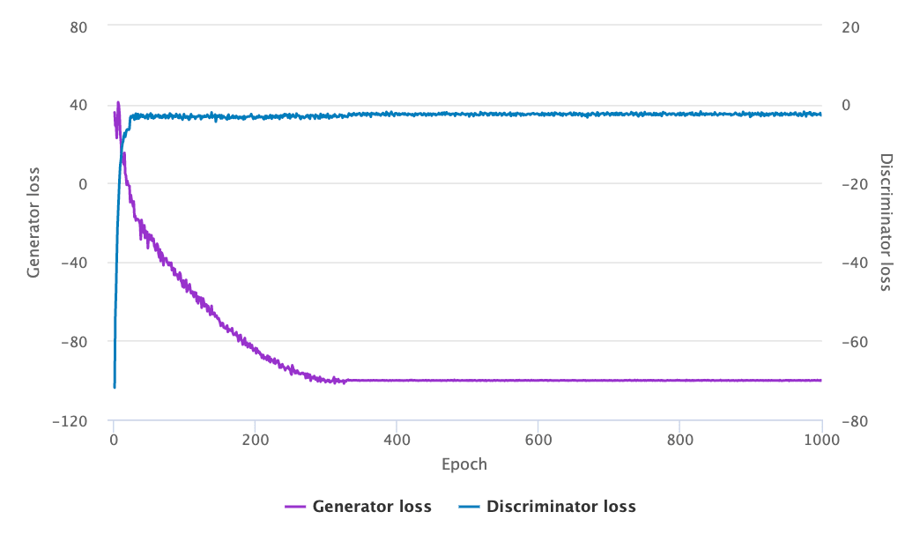
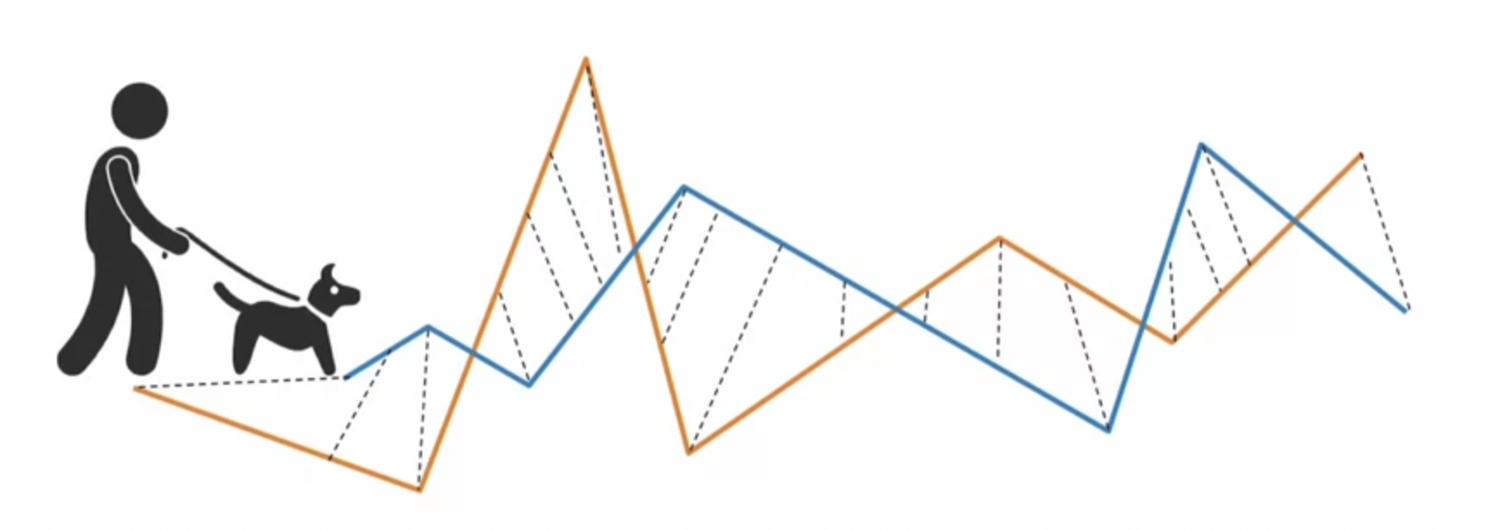
Evaluation
No objective loss function used when training GAN models
Manual inspection of generated outputs is often a good starting point
Frechet Inception Distance (FID) used as a metric currently
There are variants of FID such as Frechet Audio Distance (FAD), Frechet Video Distance (FVD), and Frechet ChemNet Distance (FCD)

Slide 11
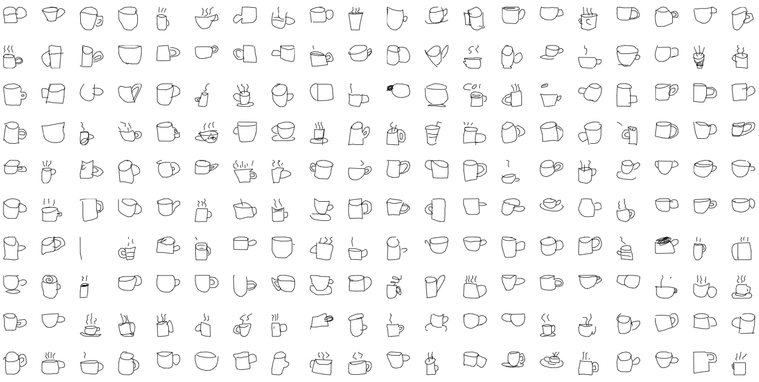
Demo with Sketches

Slide 12
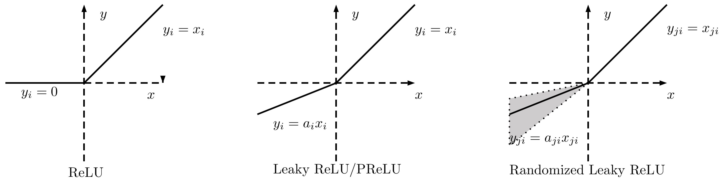
Leaky ReLU Activation

Slide 13
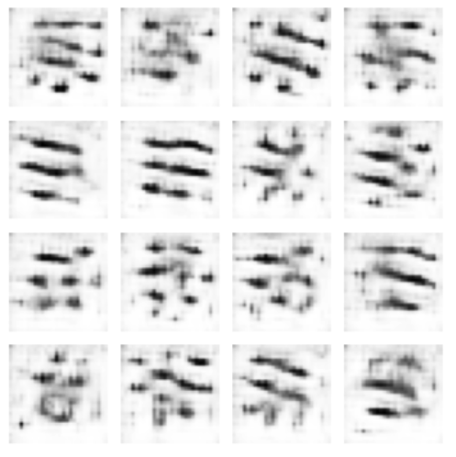
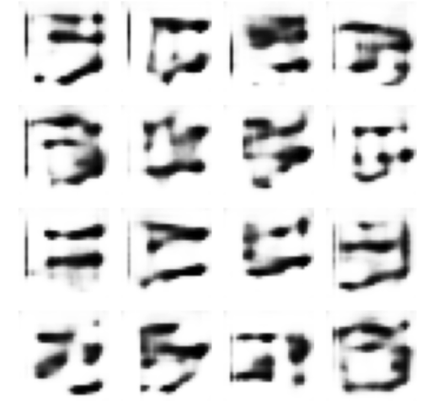
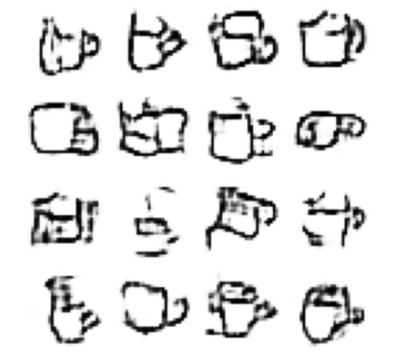
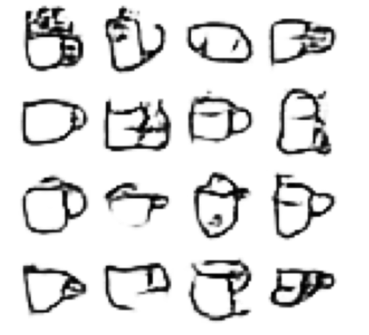
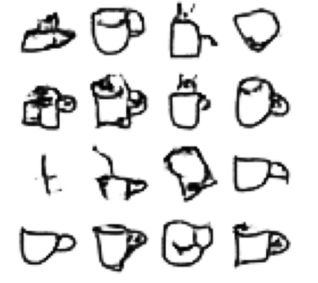
ReLU + DCGAN (Deep Convolutional GAN)
100 epochs
200 epochs
500 epochs
1000 epochs
2000 epochs

Slide 14
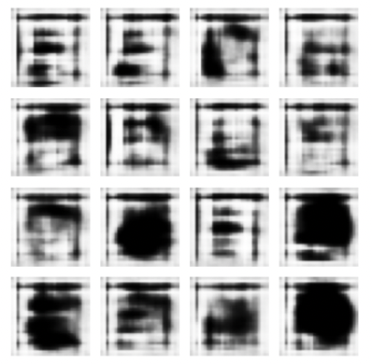
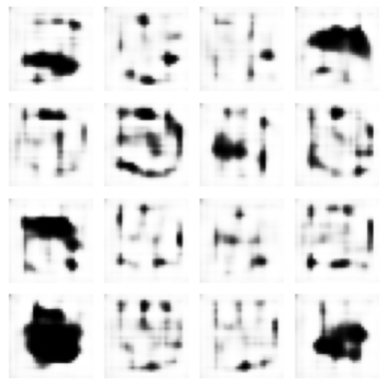
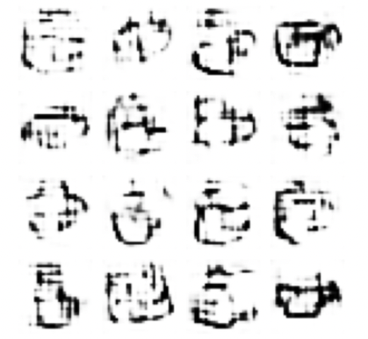
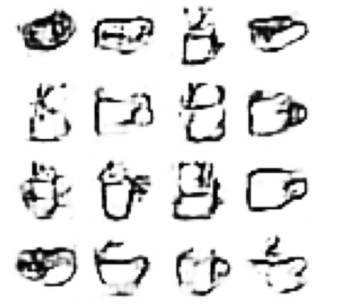
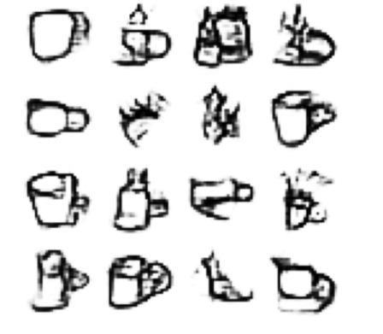
Leaky ReLU (α=0.3) + DCGAN
100 epochs
200 epochs
500 epochs
1000 epochs
2000 epochs

Slide 15
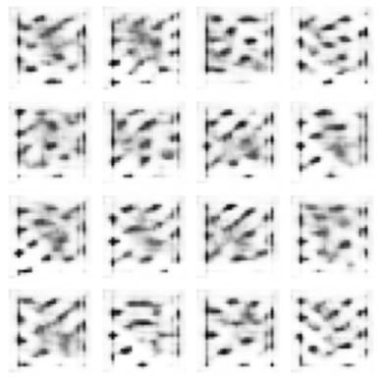
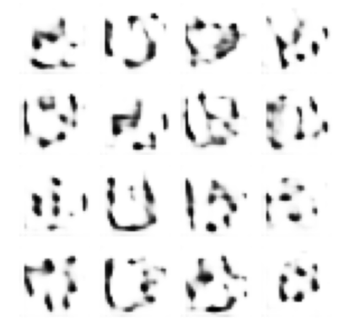
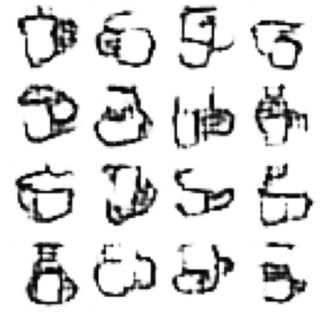
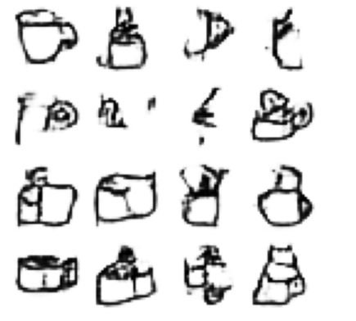
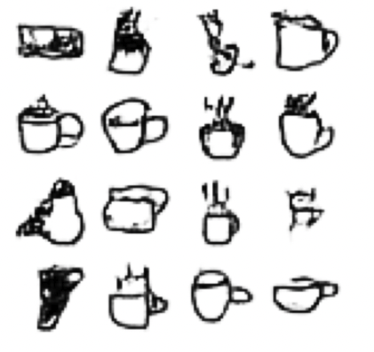
Leaky ReLU (α=0.05) + DCGAN
100 epochs
200 epochs
500 epochs
1000 epochs
2000 epochs

Slide 16
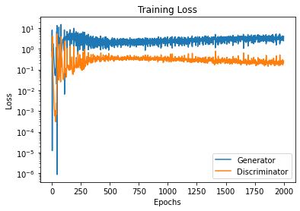
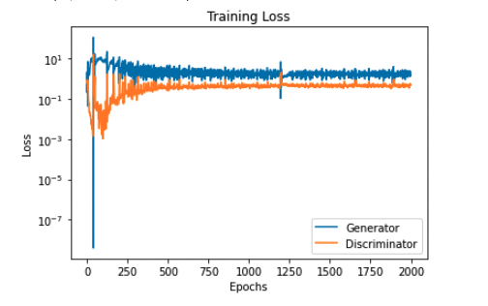
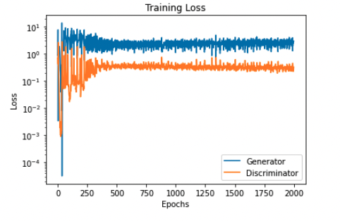
Various Loss on DCGAN
ReLU
Leaky ReLU α=0.3
Leaky ReLU α=0.05

Slide 17
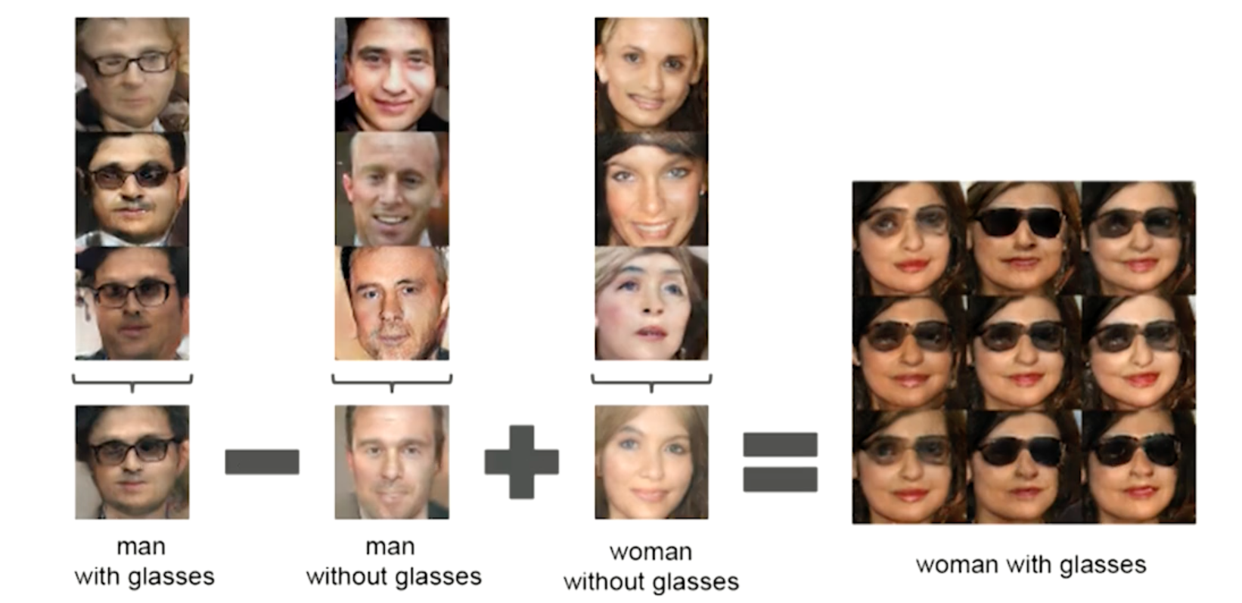
DCGAN (2015-2016)
Using a deep convolutional neural network as a discriminator
Unsupervised separation of high-level attributes (i.e. age, gender) and stochastic variation (freckles, hair)
Radford, A., Metz, L. and Chintala, S. “Unsupervised representation learning with deep convolutional generative adversarial networks.” arXiv:1511.06434 (2015)

Slide 18
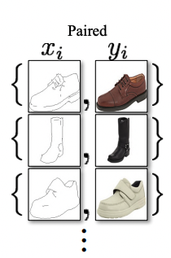
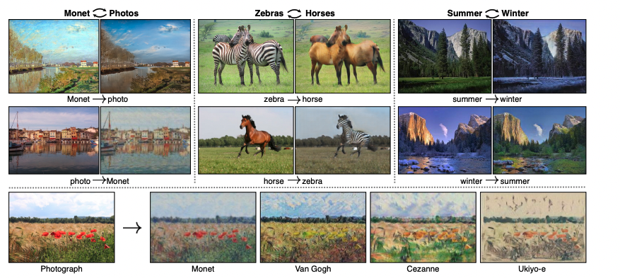
CycleGAN (2017)
Image-to-image translation
Zhu, J., Park, T., Isola, P., Efros, A.A. Unpaired Image-to-Image Translation using Cycle-Consistent Adversarial Networks. Proceedings of the IEEE International Conference on Computer Vision, 2223-2232 (2017).

Slide 19
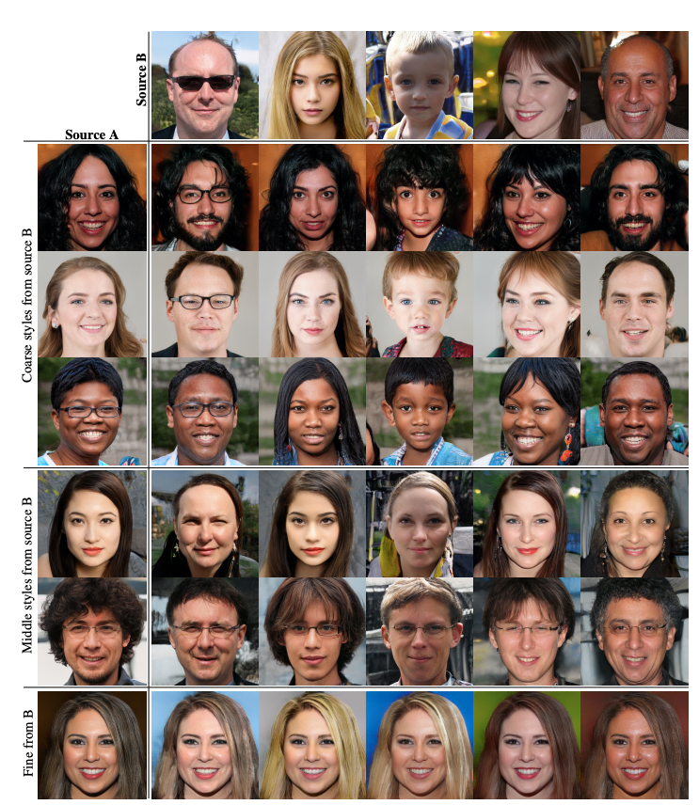
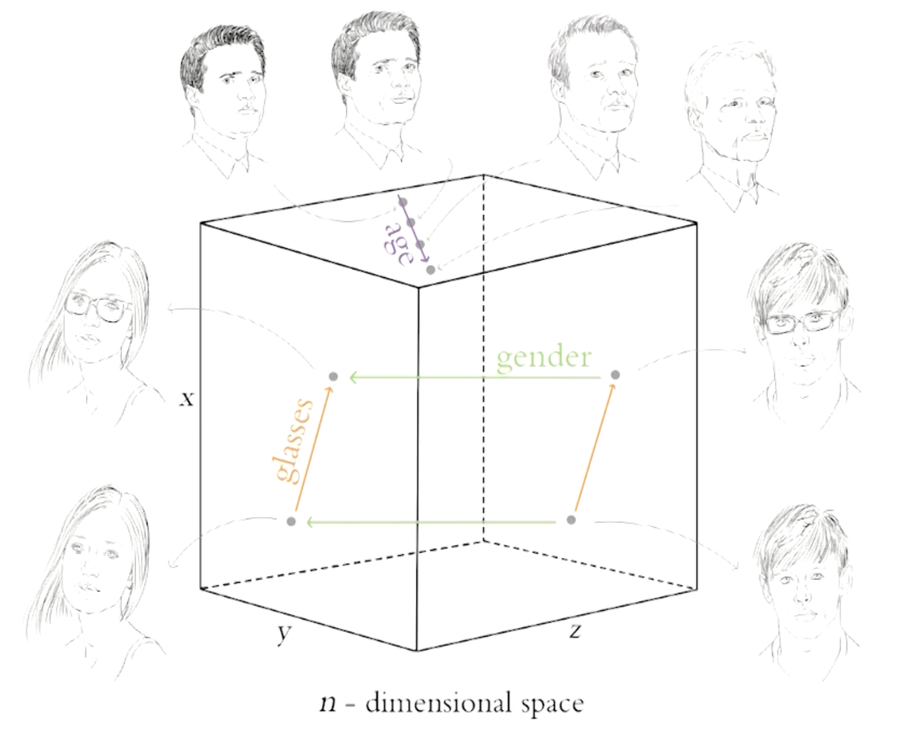
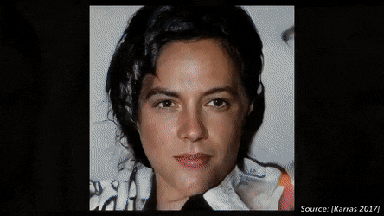
StyleGAN (2018-2019)
Using a deep convolutional neural network as a generator
Karras, T., Laine, S. and Alia, T. “A Style-Based Generator Architecture for Generative Adversarial Networks” Proceedings of the IEEE/CVF Conference on Computer Vision and Pattern Recognition, 4401-4410 (2019)
Notes:
Uses progressive growing to increase the resolution gradually
Generates images from a fixed value tensor as opposed to generating images stochastically generated latent variables

Slide 20
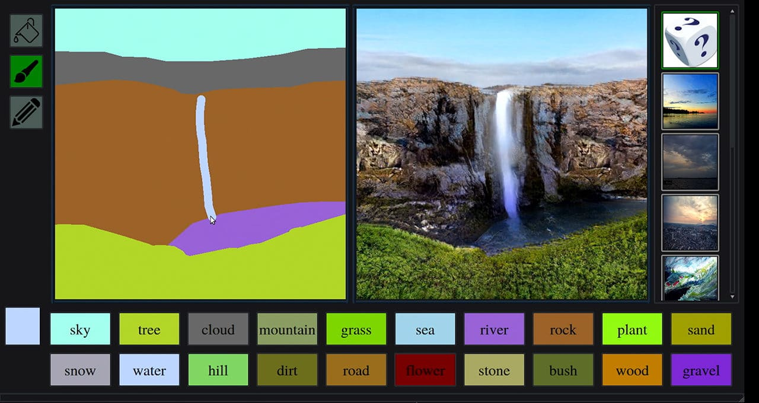
GauGAN (2019)
Park, T., Liu, M.Y., Wang, T.C. and Zhu, J.Y. “GauGAN: semantic image synthesis with spatially adaptive normalization” ACM SIGRAPH 2019 Real-Time Live!, pp. 1-1 (2019)

Slide 21
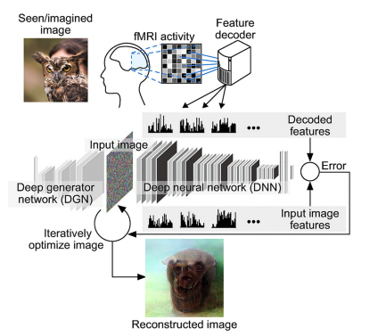
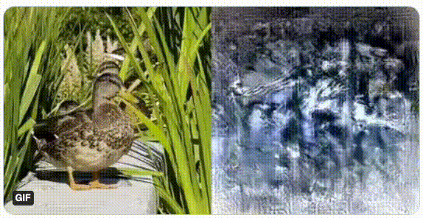
Image Construction from Brain Activity (2019)
Shen, G., Horikawa, T., Majima, K., Kamitani, Y. Deep Image Construction from Human Brain Activity. PLoS Computational Biology, 15 (1), doi:10.1371/journal.pcbi.1006633 (2019).
Notes:
Due to a limited dataset in fMRI studies, the DNN does not train directly on the fMRI scans.
Prior to that, the largest fMRI scans that have been used numbered around 6,000 training samples.
”Naturalness” of the image was improved using a GAN with concepts in StyleGAN

Slide 22
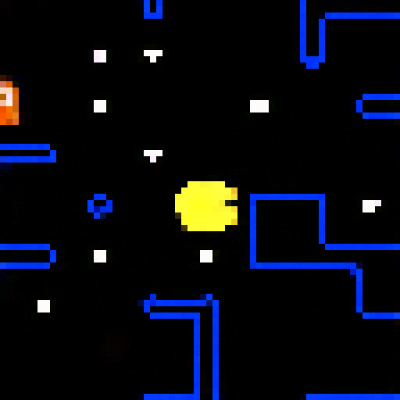
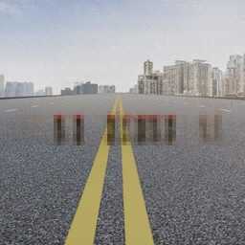
GameGAN (2020)
Generated PAC-MAN game after training on 50,000 episodes of the game
Learns static and dynamic elements of the environment and generates frames of images based on keystrokes
Seung, W.K., Zhou, Y., Philion, J., Torralba, A., Fidler, S. “ Learning to Simulate Dynamic Environments with GameGAN” Proceedings of the IEEE/CVF Conference on Computer Vision and Pattern Recognition (2020)

Slide 23
Summary
PROS
Amazing empirical results when done right – especially with fidelity
Fast inference (image generation during testing)
CONS
Lack of intrinsic evaluation metrics
Unstable training that can lead to collapse
Computationally expensive

Slide 24
References
Goodfellow, I., Pouget-Abadie, J., Mirza, M., Xu, B., Warde-Farley, D., Ozair, S., Courville, A. and Bengio, Y. “Generative Adversarial Networks” Communications of the ACM, 63(11), pp. 139-144 (2014)
Radford, A., Metz, L. and Chintala, S. “Unsupervised representation learning with deep convolutional generative adversarial networks.” arXiv:1511.06434 (2015)
Zhu, J., Park, T., Isola, P., Efros, A.A. “Unpaired Image-to-Image Translation using Cycle-Consistent Adversarial Networks.” Proceedings of the IEEE International Conference on Computer Vision, pp. 2223-2232 (2017)
Park, T., Liu, M.Y., Wang, T.C. and Zhu, J.Y. “GauGAN: semantic image synthesis with spatially adaptive normalization” ACM SIGRAPH 2019 Real-Time Live!, pp. 1-1 (2019)
Karras, T., Laine, S. and Alia, T. “A Style-Based Generator Architecture for Generative Adversarial Networks” Proceedings of the IEEE/CVF Conference on Computer Vision and Pattern Recognition, 4401-4410 (2019)
Karras, Tero. “Analyzing and Improving the Image Quality of StyleGAN” Proceedings of the IEEE/CVF Conference on Computer Vision and Pattern Recognition, (2020)
Belousov, Sergei. “MobileStyleGAN: A Lightweight Convolutional Neural Network for High-Fidelity Image Synthesis.”
Seung, W.K., Zhou, Y., Philion, J., Torralba, A., Fidler, S. “Learning to Simulate Dynamic Environments with GameGAN” Proceedings of the IEEE/CVF Conference on Computer Vision and Pattern Recognition pp. 1231-1240 (2020)
Shen, G., Horikawa, T., Majima, K., Kamitani, Y. “Deep Image Construction from Human Brain Activity.” PLoS Computational Biology, 15 (1) (2019)

Slide 25
Q&A

